Slide 1
TOR Evolution and Loss
Kyle Johnson and Dellaraam Pourkeramati
1/29/2025

Slide 2
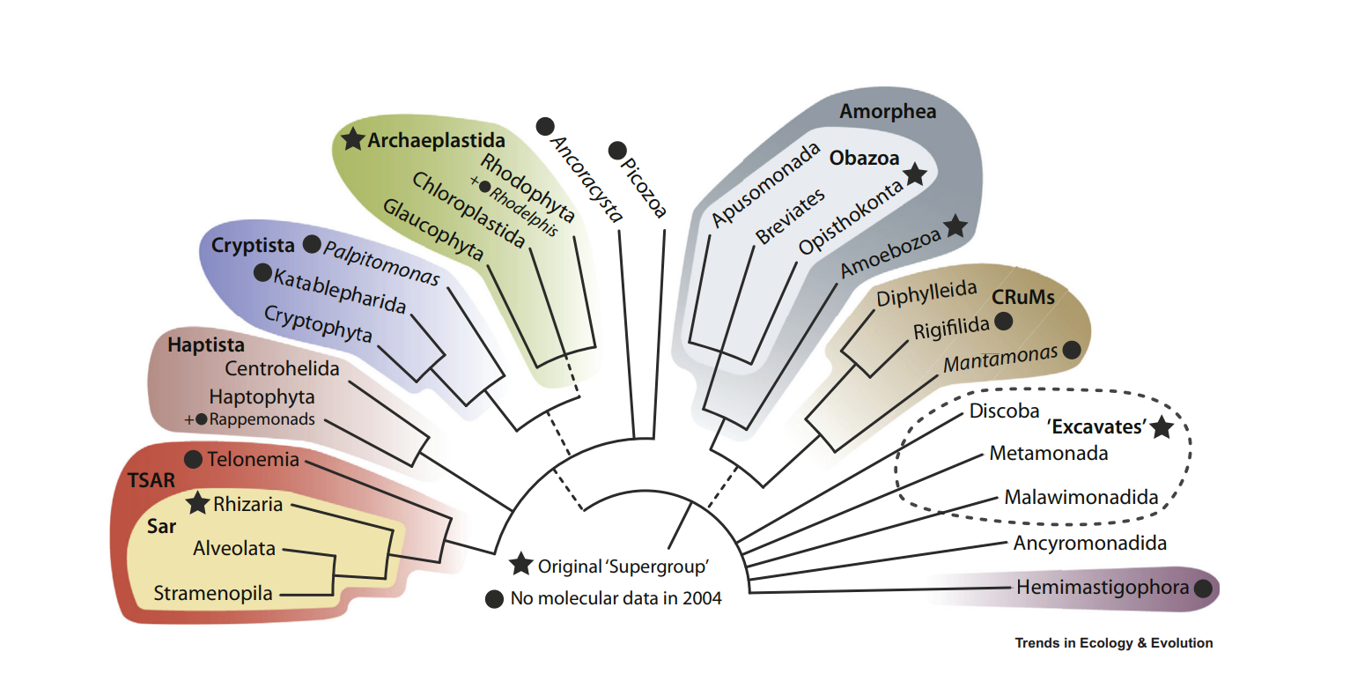
Where we started
Initial Question: Why did Plants lose TORC2? Did other organisms lose it?
Shiozaki and Tatebe (2017)
Ran HMMER over organisms present in said paper
Using data generated by HMMER, created table that confirmed/denied presence of proteins associated with TORC1 and TORC2
Established rudimentary scoring rule for “borderline” proteins
Ran Alphafold through ChimeraX for model predictions of “borderline” proteins

Slide 3
Current Questions
What is the pattern of TORC1/TORC2 presence and absence?
Can we say that LECA possessed both complexes by looking at excavata for protein components?
In Photosynthetic organisms, is there a correlation between TORC2 loss and photosynthesis and how many times has TORC2 disappeared independently in said organisms?
In the Alveolates, how many independent instances of RAPTOR loss occur?
How many other organisms have lost RAPTOR besides the Alveolata?

Slide 4
Workflow/Pipeline
Genome information from NCBI
BUSCO/HMMER/BLAST
R tables + Taxonomy
MSA
Phylogenetic Tree(s)
SRA /Diamond alignment for missing components with low c scores
Discern Patterns of component loss

Slide 5
General Pipeline for Analysis
Began with downloading proteome data from NCBI using the datasets command line package for Archaeplastida, TSAR, and Excavata
Ran HMMER using HMMs found on InterPro/Panther for the following proteins: RICTOR, RPTOR, SIN1, LST8, TOR. Default program values used at runtime.
Ran BUSCO on all Proteomes collected for quality control. Used clade specific databases provided with BUSCO
All results were combined in R language compatible files. Established scoring criteria based upon domain score values and overall score values from HMMER
Used BLAST for establishing/confirming borderline cases

Slide 6
General Pipeline for Analysis
MSAs were created from the established data for the aforementioned proteins to confirm presence of proteins. Used ClustalO and MUSCLE for alignment(s)
MSAs were then used to create custom phylogenetic trees using the FastTree program
Further trees were gathered using Organism Taxonomic Identification Numbers by using NCBI Common Tree for taxonomic grouping
Losses of proteins were mapped on to the generated tree using the HMMR data
All results were then/continued to be stored on a github repository and cluster

Slide 7
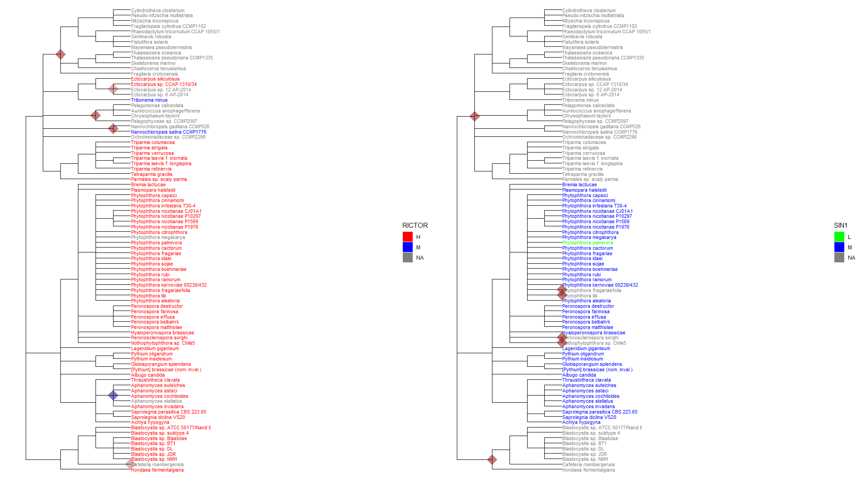
Phylogenetic Results: Stramenopiles RICTOR & SIN1

Slide 8
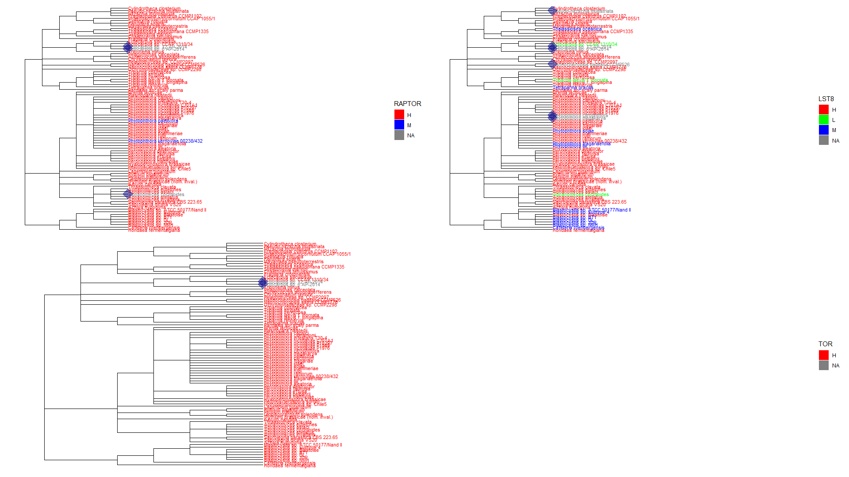
Phylogenetic Results: Stramenopiles RAPTOR,LST8,TOR

Slide 9
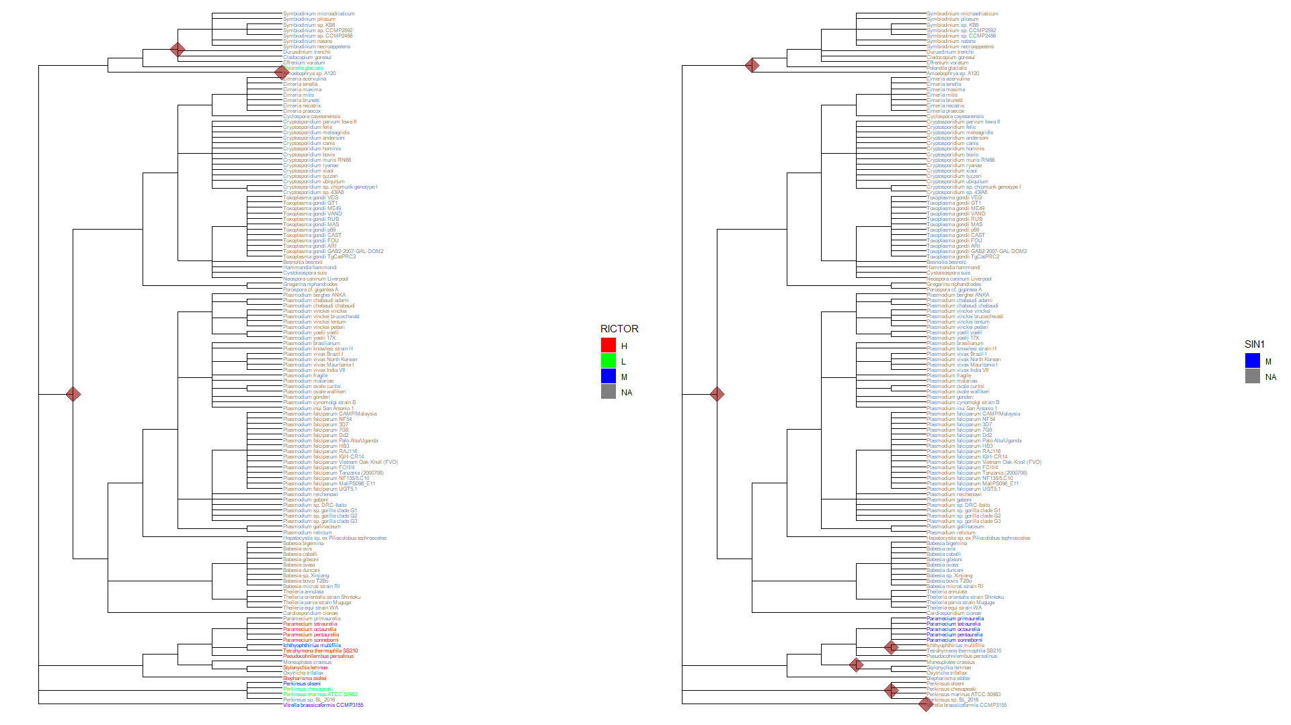
Phylogenetic Results: Alveolata RICTOR,SIN1

Slide 10
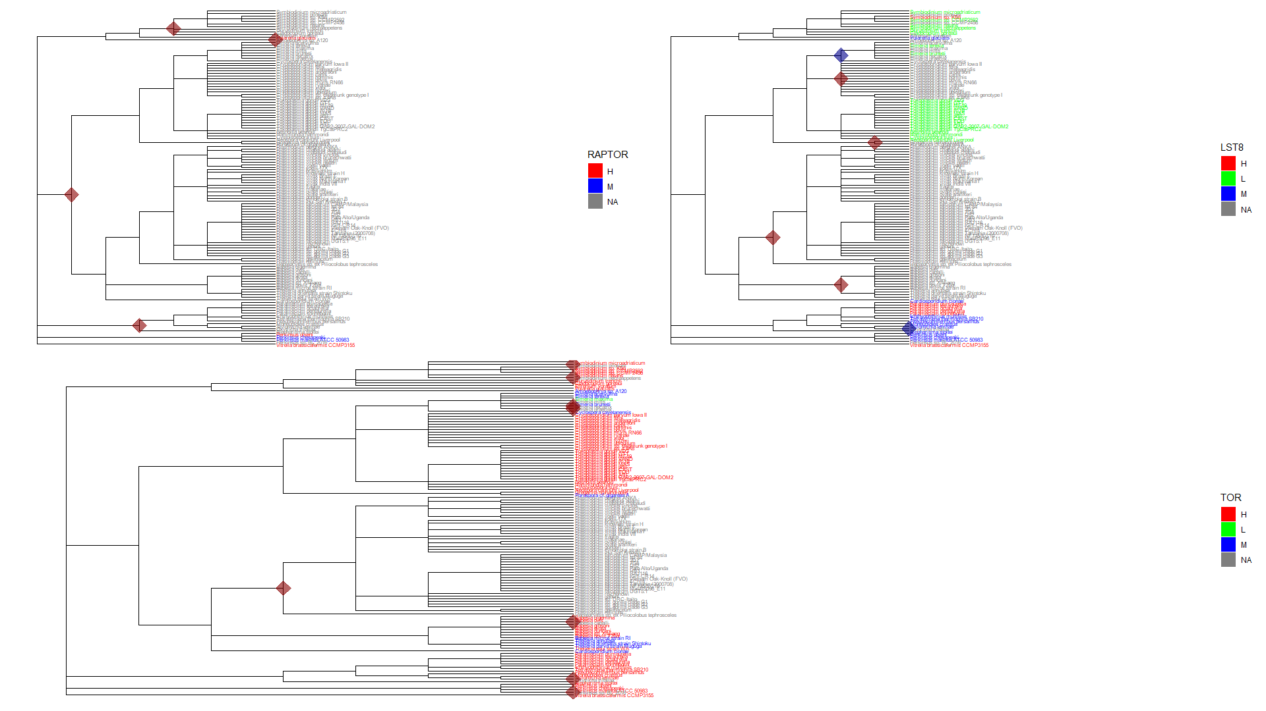
Phylogenetic Results: Alveolata RAPTOR,LST8,TOR

Slide 11
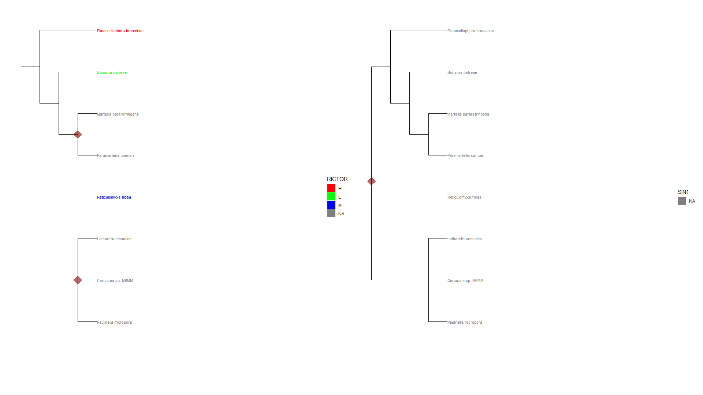
Phylogenetic Results: Rhizaria RICTOR, SIN1

Slide 12
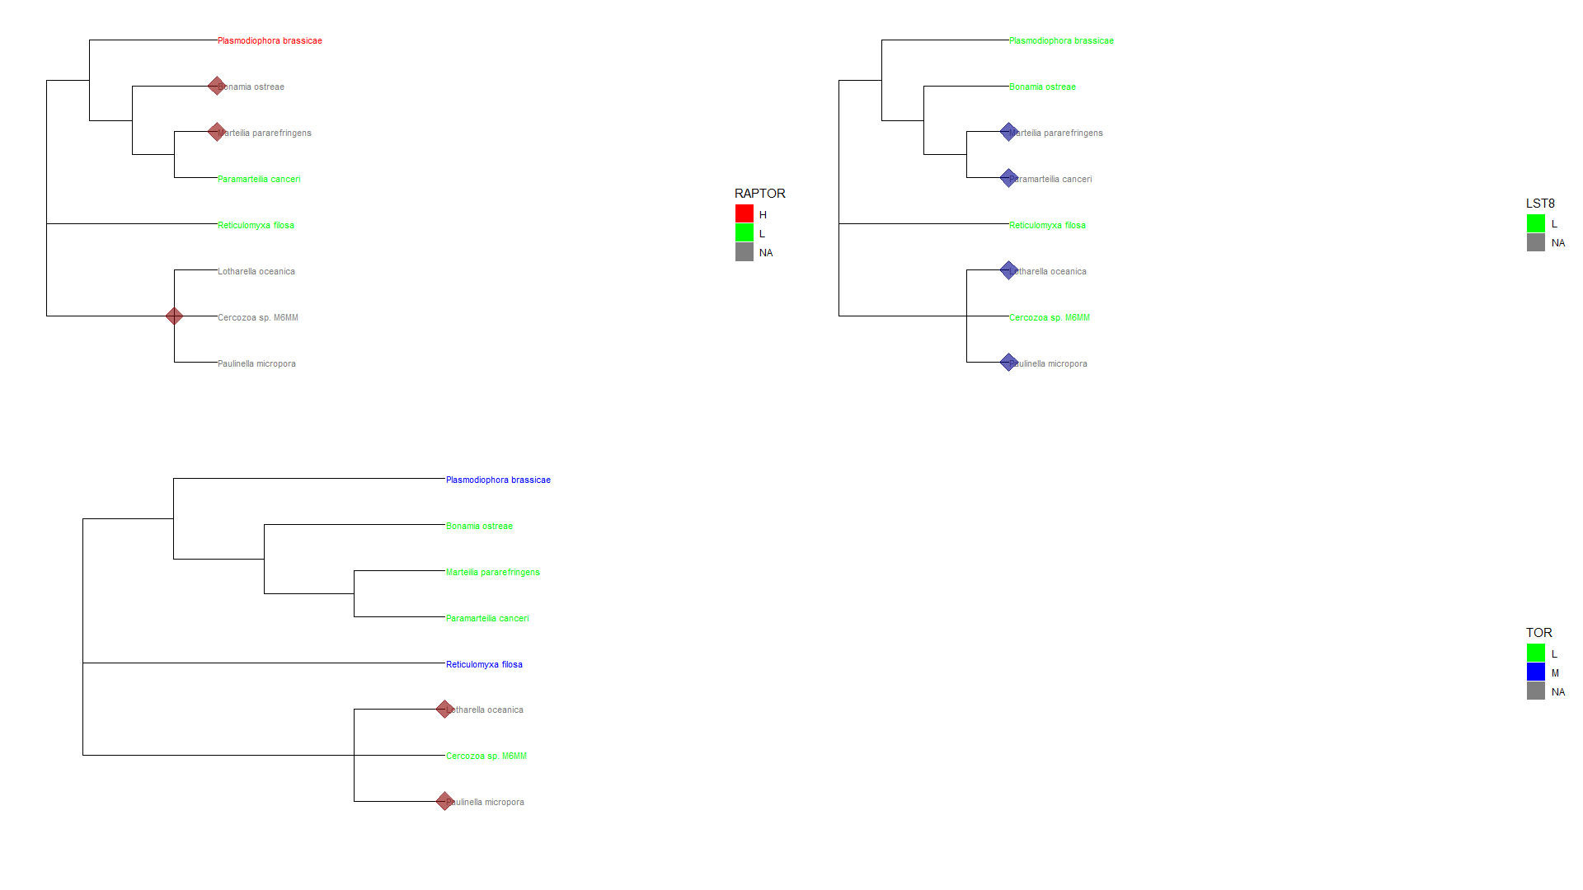
Phylogenetic Results: Rhizaria RAPTOR,LST8,TOR

Slide 13
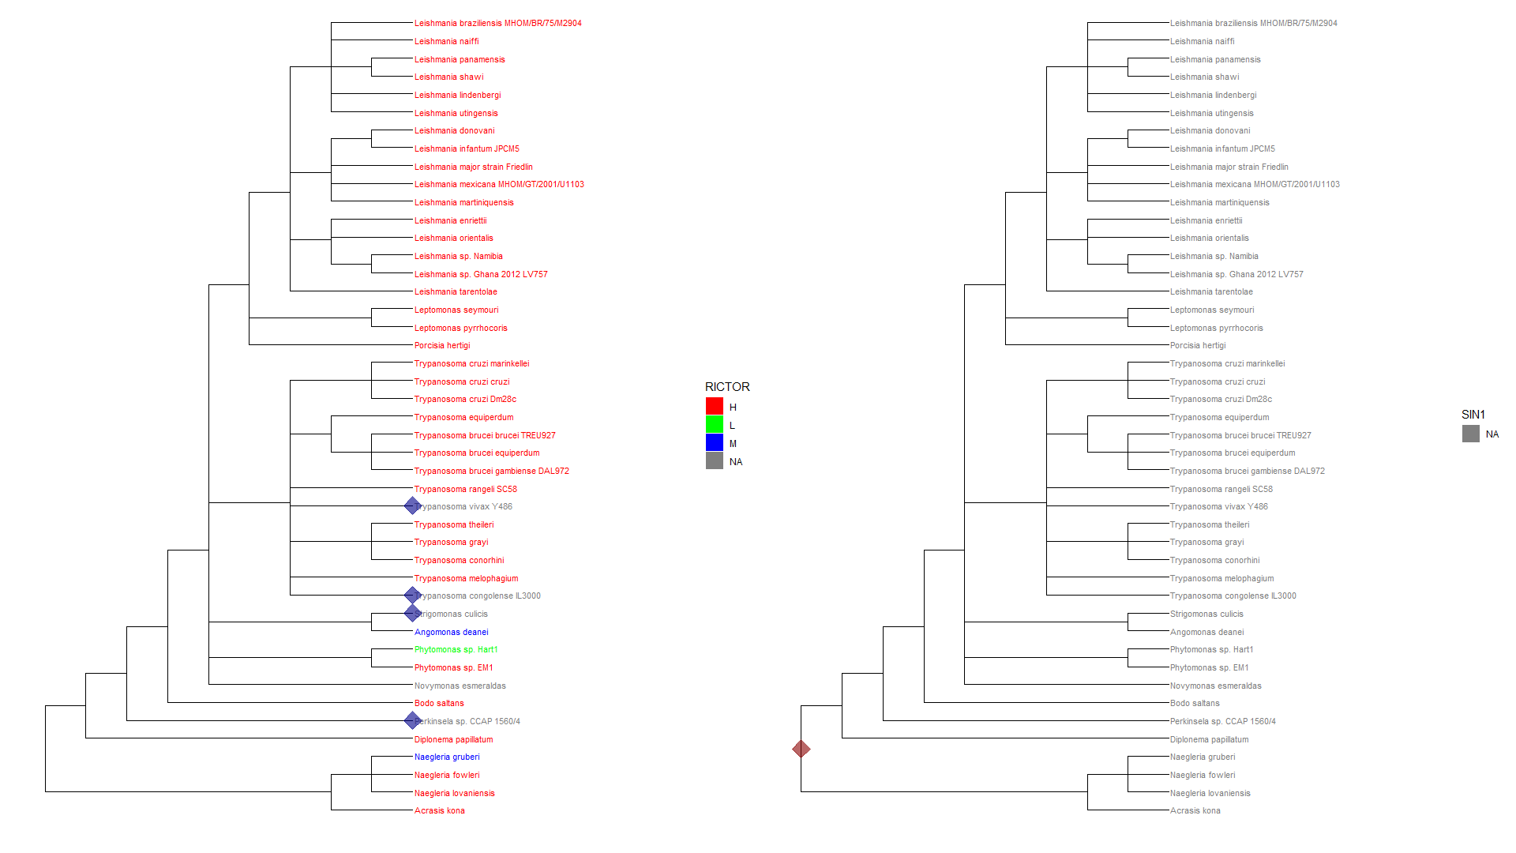
Phylogenetic Results: Discoba RICTOR,SIN1

Slide 14
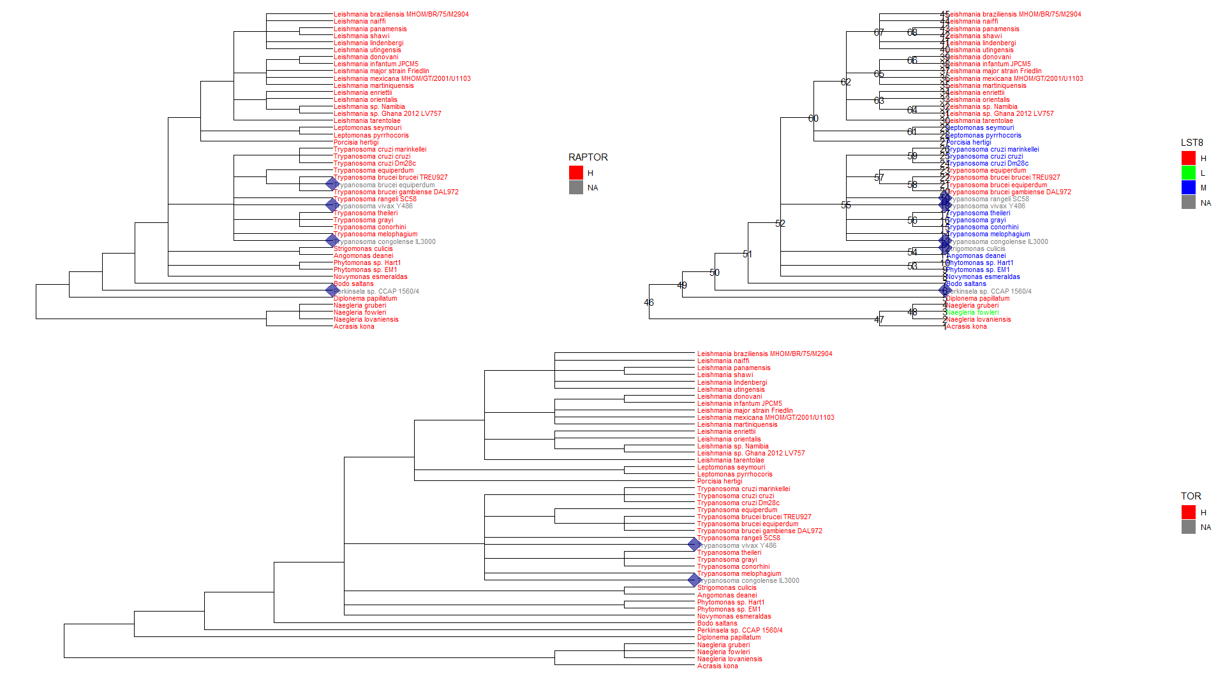
Phylogenetic Results: Discoba RAPTOR,LST8,TOR

Slide 15
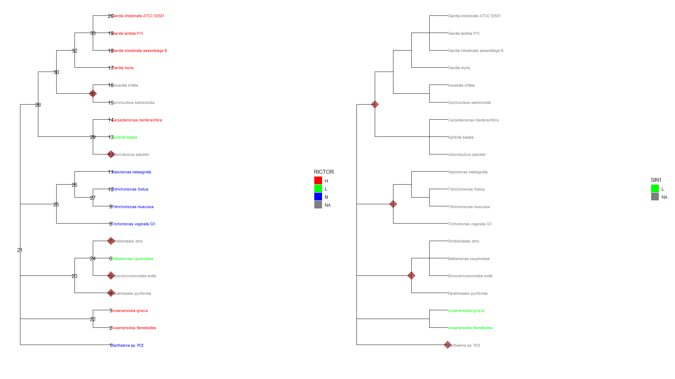
Phylogenetic Results: Metamonada RICTOR,SIN1

Slide 16
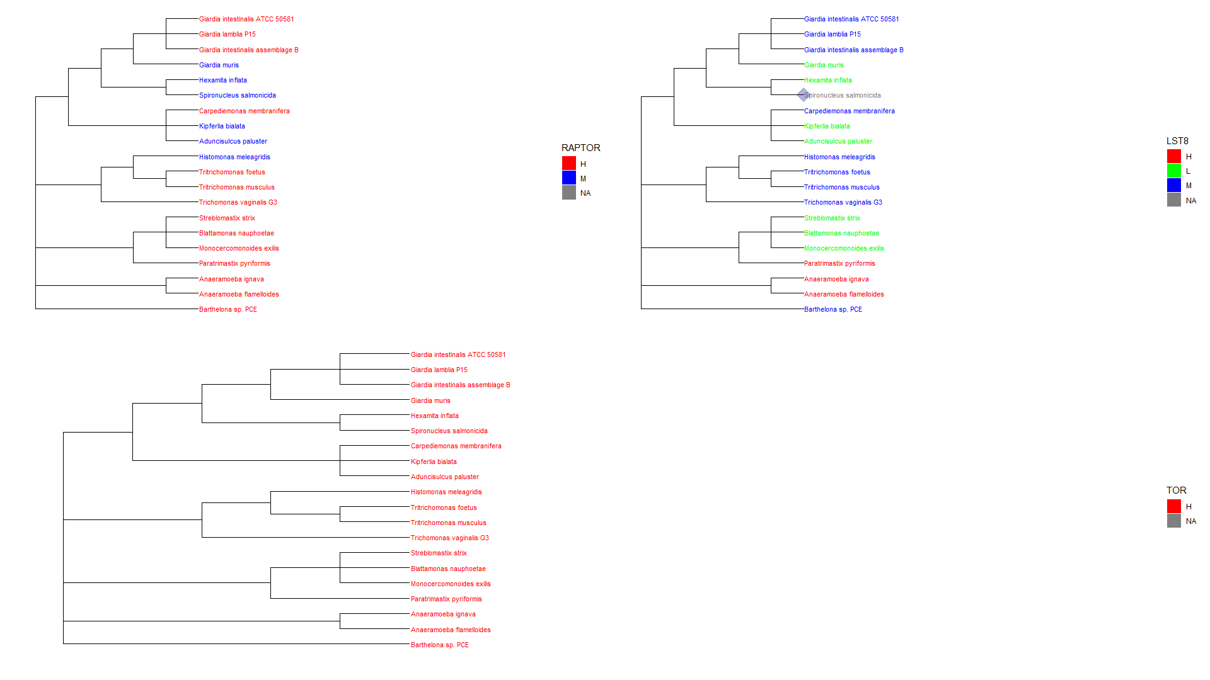
Phylogenetic Results: Metamonada RAPTOR,LST8,TOR

Slide 17
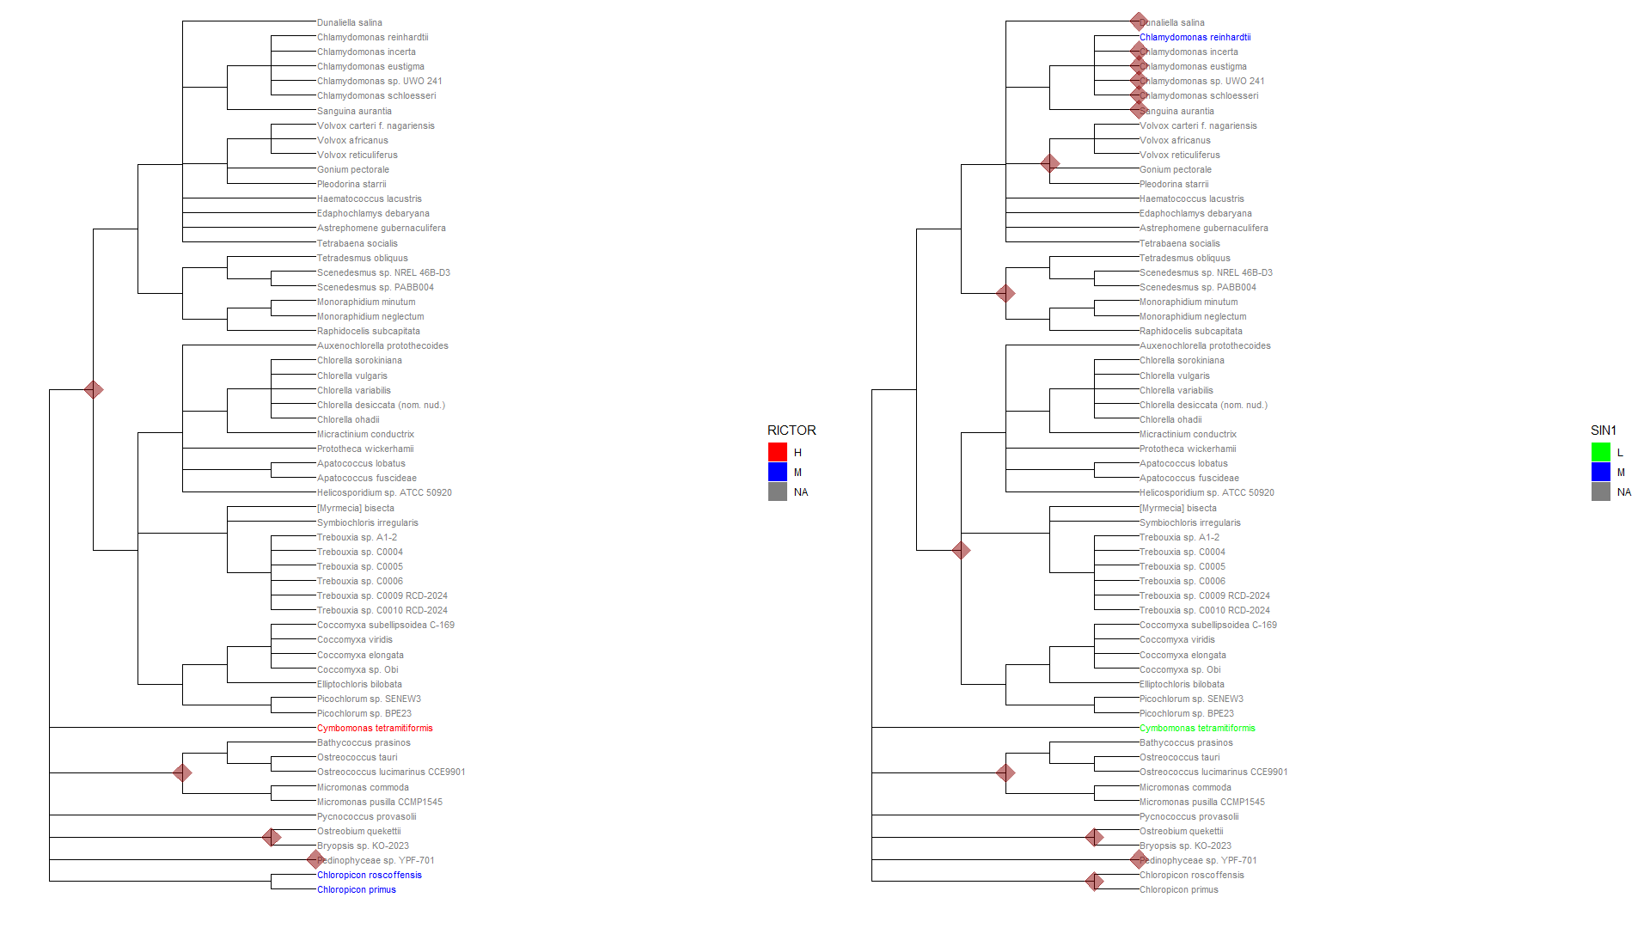
Phylogenetic Results: Chlorophyta RICTOR, SIN1

Slide 18
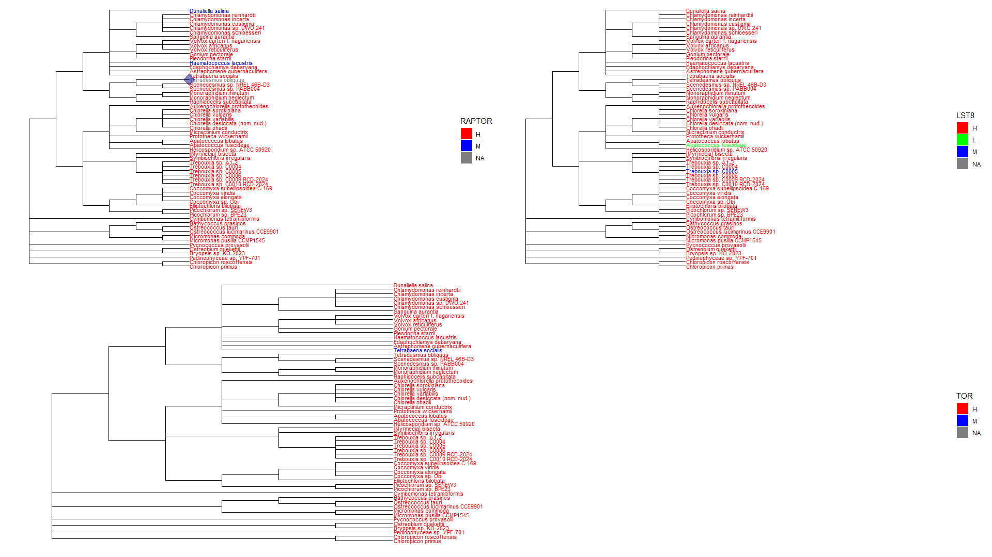
Phylogenetic Results: Chlorophyta RAPTOR,LST8, TOR

Slide 19
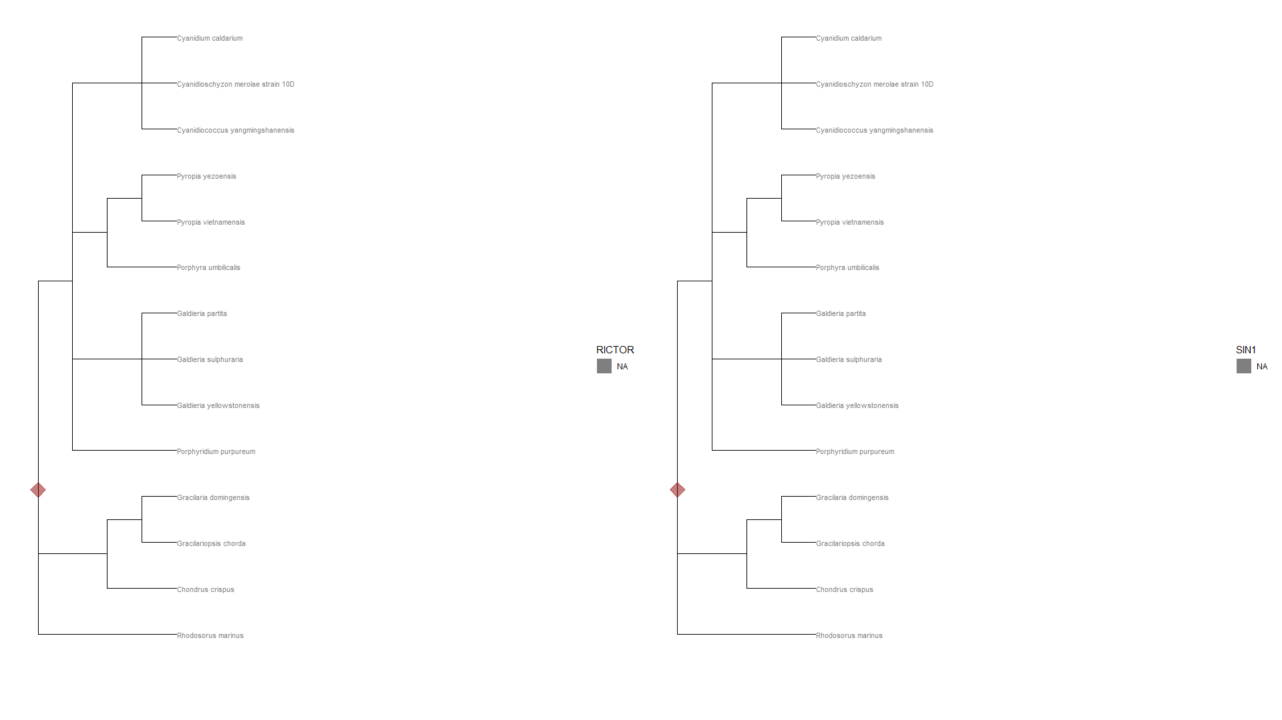
Phylogenetic Results: Rhodophyta RICTOR, SIN1

Slide 20
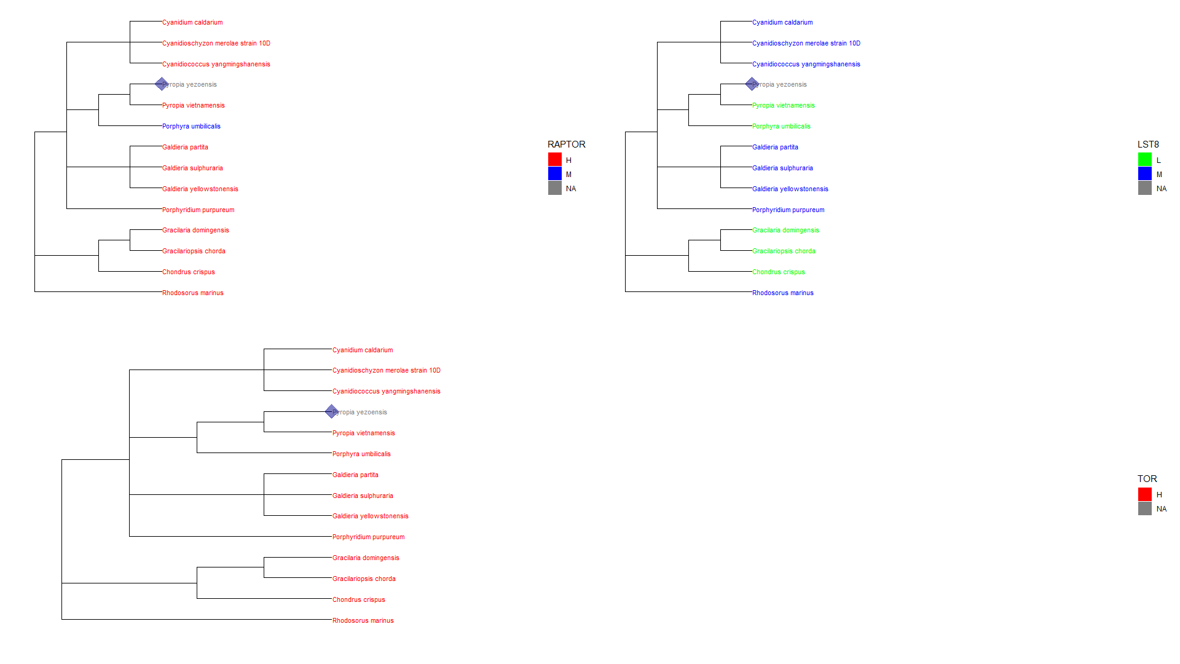
Phylogenetic Results: Rhodophyta RAPTOR, LST8, TOR

Slide 21
Streptophyta Phylogenetics and Proteins
Due to the size of the amount of Streptophyta collected, required large trees
Each tree represents the phylogenetics of Streptophyta and whether or not the species contain TORC1 and TORC2 proteins
The slides are arranged in the following order:
RICTOR
SIN1
RAPTOR
LST8
TOR

Slide 22
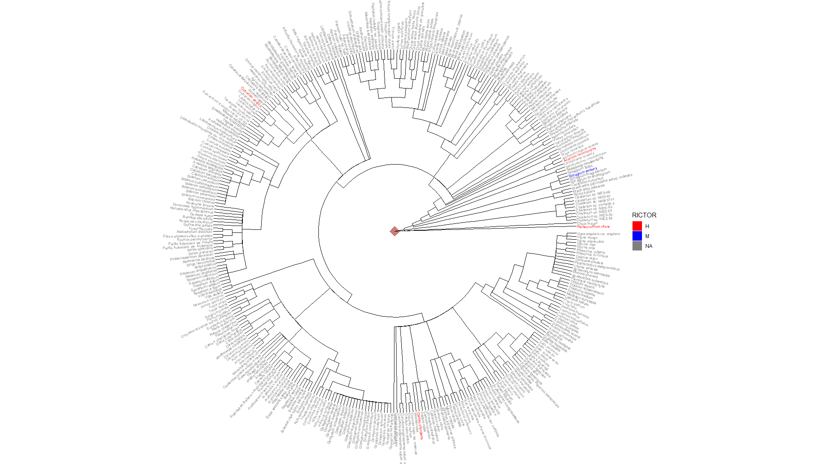

Slide 23
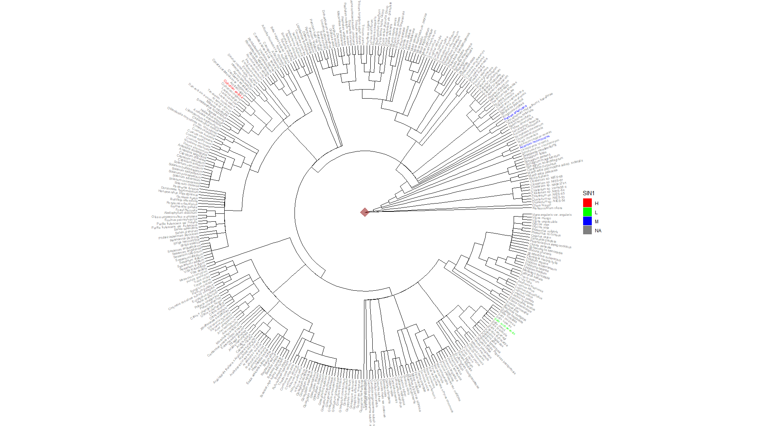

Slide 24
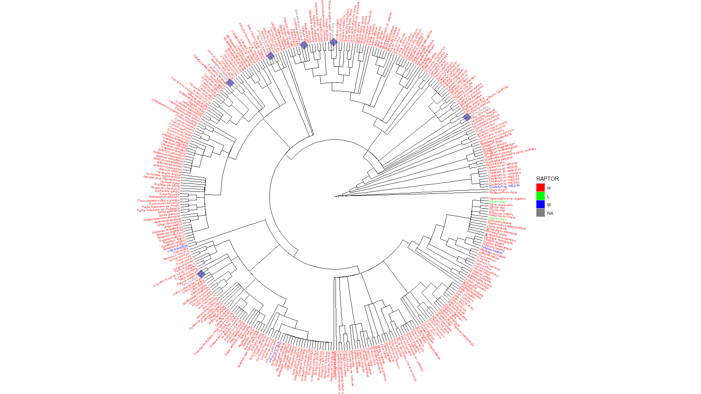

Slide 25
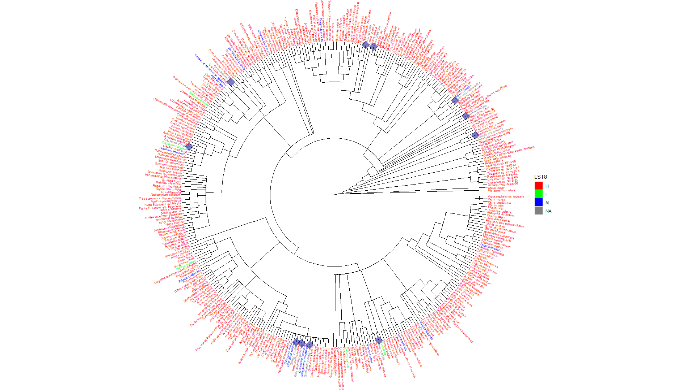

Slide 26
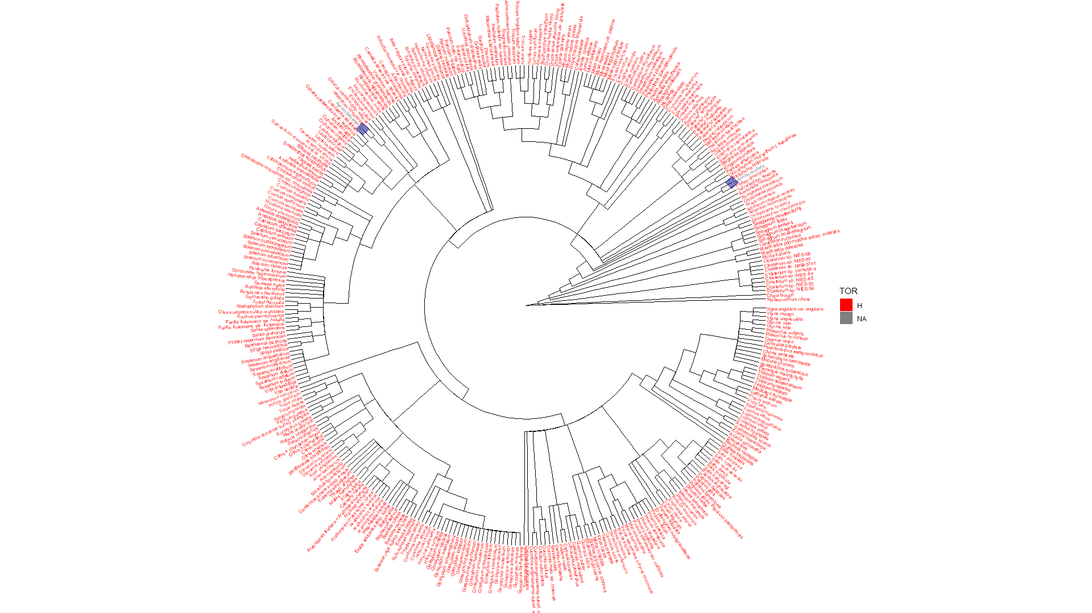

Slide 27
Discussion
Based upon the results and the data collected, we believe we can answer the following:
We argue that TORC2 losses have occurred at multiple points in evolution. Furthermore, there has even been cases of TORC1 losses throughout evolution
We argue that RICTOR was likely to exist in LECA because of its presence in excavates, thought to be closest related
RAPTOR is unlikely to be lost unless certain conditions are met
Pattern of loss seems to follow as SIN1, RICTOR, RAPTOR, LST8, TOR which is particularly seen in Alveolata
Least conserved to most conserved

Slide 28
Discussion
Ongoing Questions:
What are the conditions that lead to the loss of RAPTOR, especially in Alveolata
What ties the SIN1 protein so strongly to RICTOR that you never see it alone?
What are the links, if any, between the photosynthetic organisms/proteins and the connection to the loss of TORC2. I.E. what about photosynthesis tends to disfavor TORC2?
How functional are the TOR proteins in the species that kept them despite losing the other major component protein

Slide 29
Citations
Tatebe H, Shiozaki K. Evolutionary Conservation of the Components in the TOR Signaling Pathways. Biomolecules. 2017; 7(4):77. https://doi.org/10.3390/biom7040077
http://hmmer.org/
Eddy SR (2011) Accelerated Profile HMM Searches. PLOS Computational Biology 7(10): e1002195. https://doi.org/10.1371/journal.pcbi.1002195
Jumper, J., Evans, R., Pritzel, A. et al. Highly accurate protein structure prediction with AlphaFold. Nature 596, 583–589 (2021). https://doi.org/10.1038/s41586-021-03819-2
Meng EC, Goddard TD, Pettersen EF, Couch GS, Pearson ZJ, Morris JH, et al. UCSF ChimeraX: Tools for structure building and analysis. Protein Science. 2023; 32(11):e4792. https://doi.org/10.1002/pro.4792
https://www.ebi.ac.uk/interpro/
https://pantherdb.org/
https://blast.ncbi.nlm.nih.gov/
Mosè Manni, Matthew R Berkeley, Mathieu Seppey, Felipe A Simão, Evgeny M Zdobnov, BUSCO Update: Novel and Streamlined Workflows along with Broader and Deeper Phylogenetic Coverage for Scoring of Eukaryotic, Prokaryotic, and Viral Genomes. Molecular Biology and Evolution, Volume 38, Issue 10, October 2021, Pages 4647–4654
Sievers, F. and Higgins, D.G. (2018), Clustal Omega for making accurate alignments of many protein sequences. Protein Science, 27: 135-145. https://doi.org/10.1002/pro.3290
https://www.drive5.com/muscle/
https://morgannprice.github.io/fasttree/
https://www.ncbi.nlm.nih.gov/Taxonomy/CommonTree/wwwcmt.cgi

